Slide 1
The Battle of Neighborhoods London Housing Market 2019 (Jan-May)
By Xiaoyan (Elva) Ma

Slide 2
Content
Introduction
1. Background description
2. Business Problem
Data Collection
Methodology
1. Data preprocessing
2. Explore and Understand Data
3. Modeling
4. Clustering
Conclusion

Slide 3
Introduction
1. Background description
Home price in London growth has been gradually slowing ever since the summer of 2016. A moribund market is preventing potential sellers from bringing their homes to the market and an ongoing decline in new instructions being listed for sale has intensified of late. A recent survey of U.K. residential property from the Royal Institution of Chartered Surveyors (RICS) concluded that Brexit is currently the main obstacle for market activity. And uncertainty over how the U.K. leaves the European Union was holding back both buyers and sellers of property. House prices may be continuing to fall with the number of new inquiries down for the eighth consecutive month,

Slide 4
Introduction
2. Business Problem
Suppose I am a professional real estate trading consultant, my clients come to my office and ask me how can I assist them to purchase a suitable real estate in London in this uncertain economic? What they can put their money on?

Slide 5
Data Collection
Price Paid Data includes information on all property sales in England and Wales that are sold for full market value and are lodged with registration. The files include standard and additional price paid data transactions received at HM Land Registry in the period from January 1st to May 31st in 2019 at https://www.gov.uk/government/statistical-data-sets/price-paid-data-downloads.
The following fields comprise the address data included in Price Paid Data: Postcode; PAON Primary Addressable Object Name. Typically, the house number or name; SAON Secondary Addressable Object Name. If there is a sub-building, for example, the building is divided into flats, there will be a SAON; Street; Locality; Town/City; District; County.

Slide 6
Methodology
To explore and target recommended locations across different venues according to the presence of amenities and essential facilities, I will access data through FourSquare API interface and arrange them as a data frame for visualization. By merging data on London properties and the relative price paid data from the HM Land Registry and data on amenities and essential facilities surrounding such properties from FourSquare API interface, I will be able to recommend profitable real estate investments.
The necessary libraries will be used in this processing are: os, numpy, pandas, datetime, json, Nominatim, requests, matplotlib.cm, and folium.

Slide 7
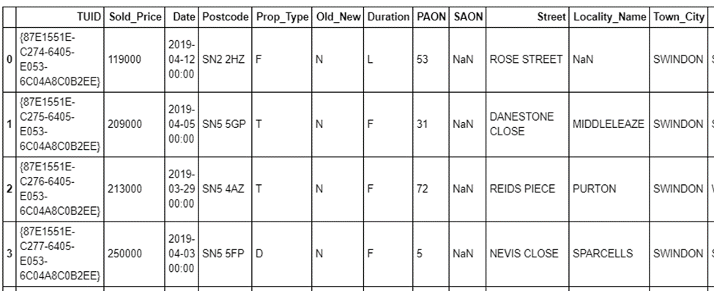
Methodology
1. Data preprocessing
This dataset consists is over 211899 rows and 16 columns. The original data without the headers cannot be process, so first I created a header for each column as 'TUID', 'Sold_Price', 'Date', 'Postcode', 'Prop_Type', 'Old_New', 'Duration', 'PAON', 'SAON', 'Street', 'Locality_Name', 'Town_City', 'District', 'County', 'PPD_Cat_Type' and 'Record_Status'.

Slide 8
Methodology
2. Explore and Understand Data
I need to format the date column and sort by date of sale, make a list of street names in London city and give meaningful names to the columns as Street and Average Price. In this case I limited the average price purchase power from 1 million to 2.8 million.
Pair of IP address to geographical location to provide geolocation data of Latitude and Longitude for each street
Create map of London using latitude and longitude values and add marker to map. The print show on below map in color red and orange are the target properties that match our request as the average price is between 1 million to 2.8 million. And I can see most they are in West London, South West and North West London

Slide 9
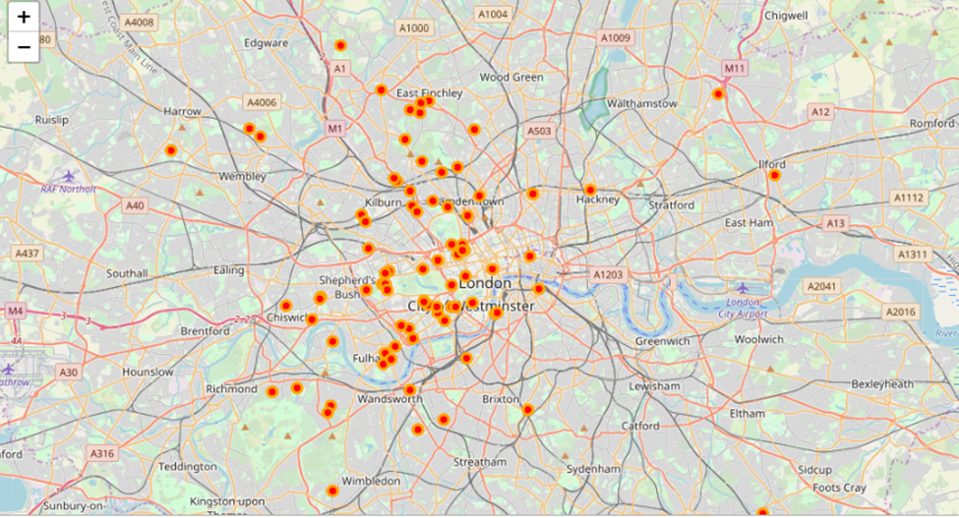
Methodology
2. Explore and Understand Data

Slide 10
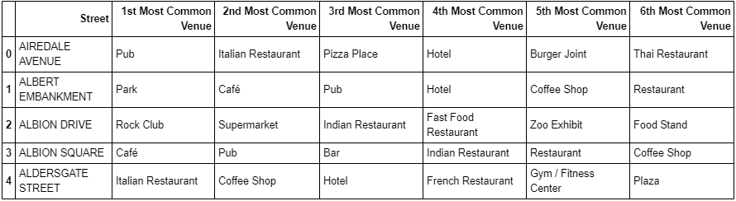
Methodology
3. Modeling
In this step I will explore the first neighborhood into the data frame, first I create a function to process to all the streets I target in London and establish a new dataframe with the 124 rows and 6 columns
I analyze each street by add street column back to dataframe and fixed it. I got 123 rows and 331 columns of streets grouped in London. And found out each street along with the top 6 most common venues

Slide 11
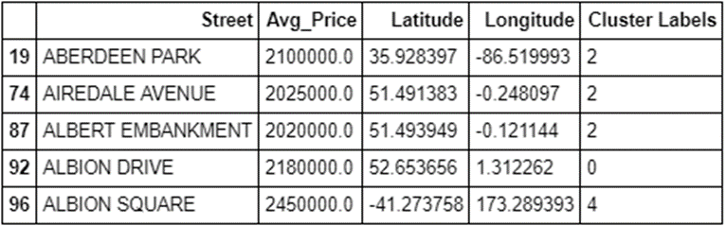
Methodology
4. Clustering
In this step I start to cluster the properties by venues, facukutues, amenitites nearby the most profitable real estate investments in London. First I set number of clusters is 5, run K-means clustering and check cluster labels generated for each row in the dataframe. For example,
Aberdeen Park is label in cluster 2, Albion Drive is label in cluster 0 and Albion Square is label in cluster 4

Slide 12
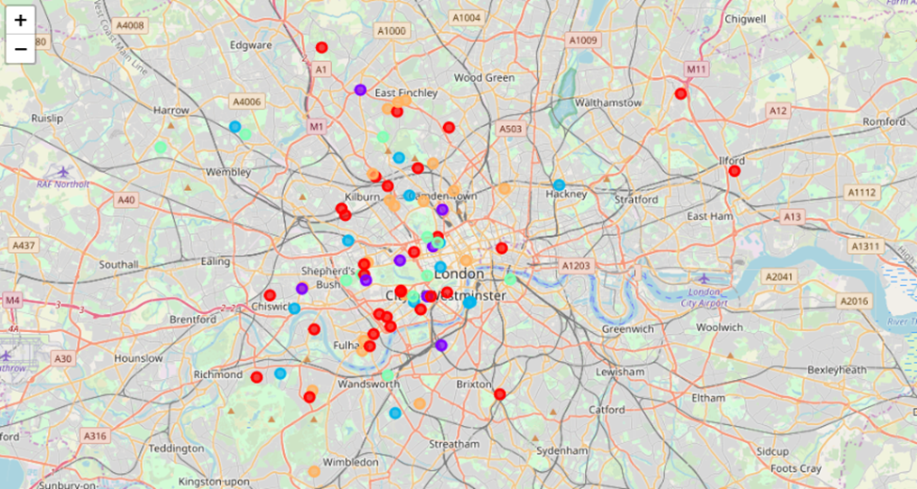
Methodology
4. Clustering
And all cluster can be display on below map that West London (Notting Hill, Kensington, Chelsea, Marylebone) and North-West London (Hampsted) might be considered highly profitable venues to purchase a real estate according to amenities and essential facilities surrounding

Slide 13
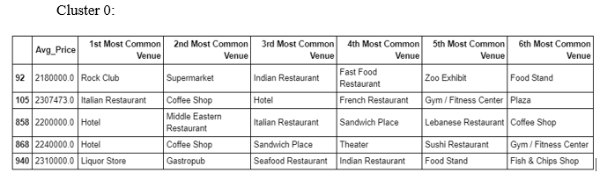
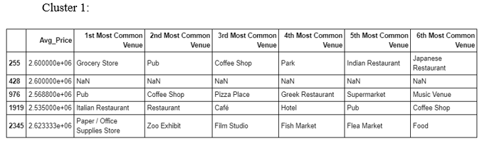
Methodology
4. Clustering
And each cluster can also show in dataframe as following:

Slide 14
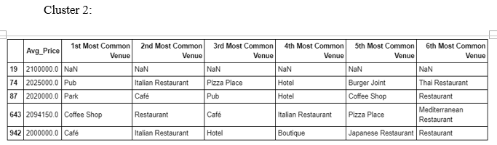
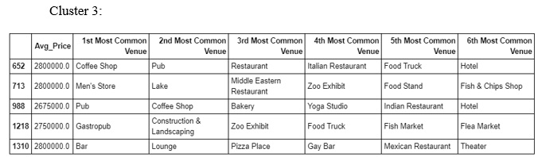
Methodology
4. Clustering

Slide 15
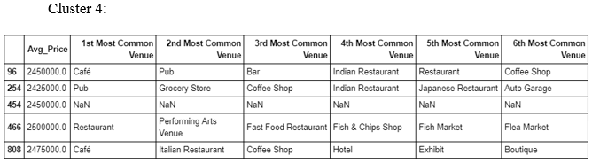
Methodology
4. Clustering

Slide 16
Conclusion
After processing all the above data and I can summaries and recommend that West London (Notting Hill, Kensington, Chelsea, Marylebone) and North-West London (Hampsted) might be considered highly profitable venues to purchase a real estate according to amenities and essential facilities surrounding. I also clustered 5 area that
Cluster 0: 1st most common venue in are club, restaurant hotel and liquor store, this cluster will be highly recommended for our client who want to invest for business traveler or sightseeing;
Cluster 1, 2 and 4: most common venue in those clusters are grocery stores, Pub, restaurants, cafe and supermarkets. Those area target home buyers prone to invest the residential live, people living in this area will be very convenient for shopping everything they need.
Cluster 3: most common venue are coffee shop, men’s store, pub, and bar. This cluster will be called recreation area, it can be targeted for people who enjoy relaxation life after work.

